Slide 1


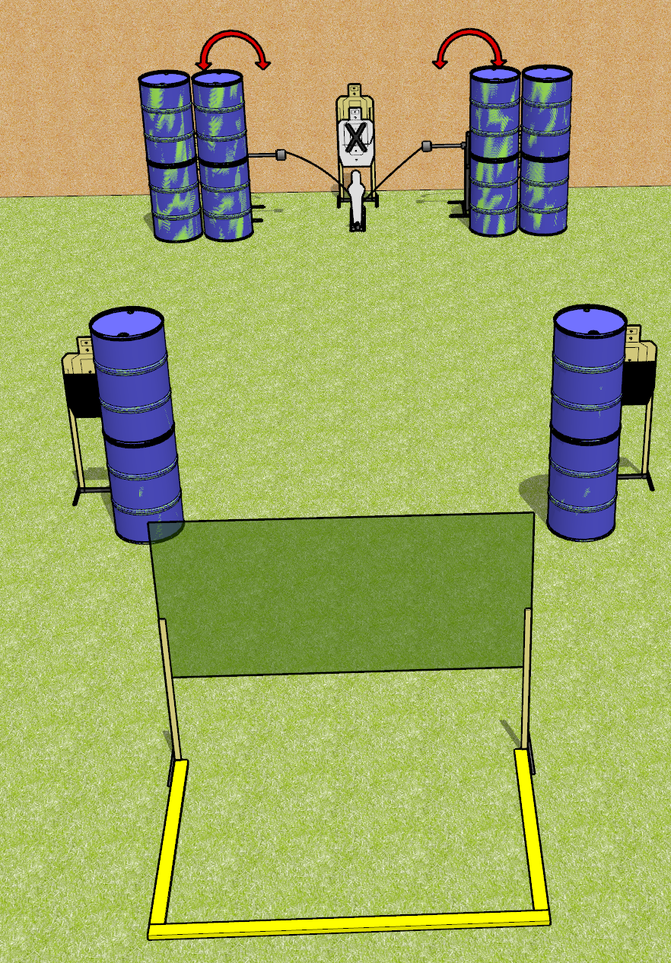
 | Dothan Gun Club – USPSA Match Partial Pain Course Designer : Drew Coleman
START POSITION : See back
GUN READY CONDITION : See back |  | SCORING: Comstock, 11 rounds TARGETS: 5 paper, 1 Steel SCORED HITS: Best 2 on paper, steel until down START-STOP: Audible, last shot RULES:
STAGE PROCEDURE: See back

Slide 2
Partial Pain
Written Stage Briefing
Partial Pain is an 11 round, 55 point, Comstock short course. There are 5 USPSA targets and 1 USPSA mini popper. The best two hits on paper will score, and steel must fall to score. The start signal is audible.
The mini popper activates both swingers, which are not disappearing. Please check the activators prior to walkthrough, and set them the same way every time.
Handgun start position is toes touching the rear fault line, facing uprange, wrists above shoulders. Handgun has loaded magazine inserted, empty chamber, hammer down.
PCC start position is heels touching the rear fault line, facing down range, stock on belt. Carbine has a loaded magazine inserted, empty chamber, safety on.
On start signal, engage targets as they become available from within the shooting area. Perform a mandatory reload before the last shot fired. Failure to perform a mandatory reload will incur a procedural penalty.

